Slide 1
CHAPTER 2 ENERGY, ENERGY TRANSFER, AND GENERAL ENERGY ANALYSIS

Slide 2
Objectives
Introduce the concept of energy and define its various forms.
Discuss the nature of internal energy.
Define the concept of heat and the terminology associated with energy transfer by heat.
Define the concept of work, including electrical work and several forms of mechanical work.
Introduce the first law of thermodynamics, energy balances, and mechanisms of energy transfer to or from a system.
Determine that a fluid flowing across a control surface of a control volume carries energy across the control surface in addition to any energy transfer across the control surface that may be in the form of heat and/or work.
Define energy conversion efficiencies.
Discuss the implications of energy conversion on the environment.

Slide 3
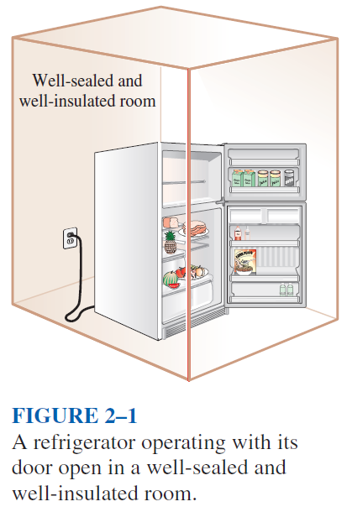
INTRODUCTION
If we take the entire room—including the air and the refrigerator (or fan)—as the system, which is an adiabatic closed system since the room is well-sealed and well-insulated, the only energy interaction involved is the electrical energy crossing the system boundary and entering the room.
As a result of the conversion of electric energy consumed by the device to heat, the room temperature will rise.

Slide 4
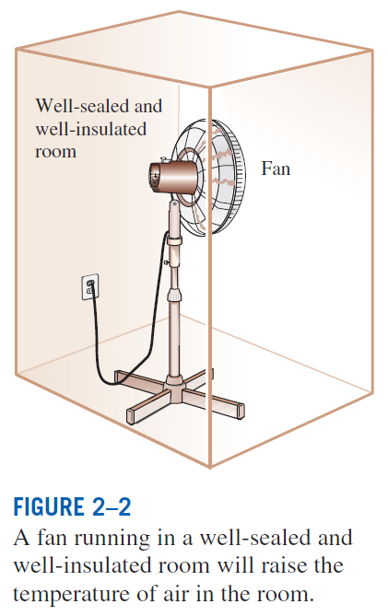

Slide 5
FORMS OF ENERGY
Energy can exist in numerous forms such as thermal, mechanical, kinetic, potential, electric, magnetic, chemical, and nuclear, and their sum constitutes the total energy, E of a system.
Thermodynamics deals only with the change of the total energy.
Macroscopic forms of energy: Those a system possesses as a whole with respect to some outside reference frame, such as kinetic and potential energies.
Microscopic forms of energy: Those related to the molecular structure of a system and the degree of the molecular activity.
Internal energy, U: The sum of all the microscopic forms of energy

Slide 6
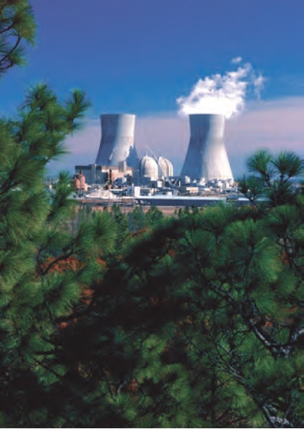

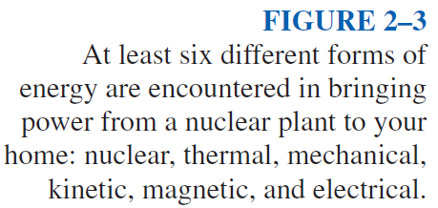

Slide 7
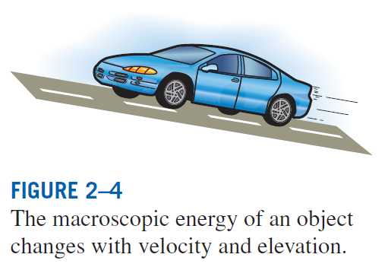
Kinetic energy, KE: The energy that a system possesses as a result of its motion relative to some reference frame.
Potential energy, PE: The energy that a system possesses as a result of its elevation in a gravitational field.

Slide 8
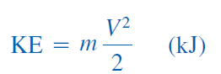
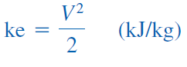
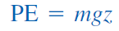
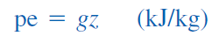
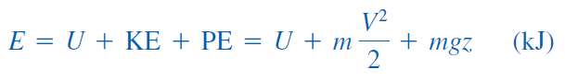
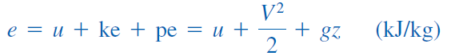
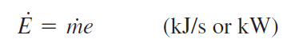
Kinetic energy
Kinetic energy per unit mass
Potential energy
Potential energy per unit mass
Total energy of a system
Energy of a system per unit mass
Energy flow rate

Slide 9
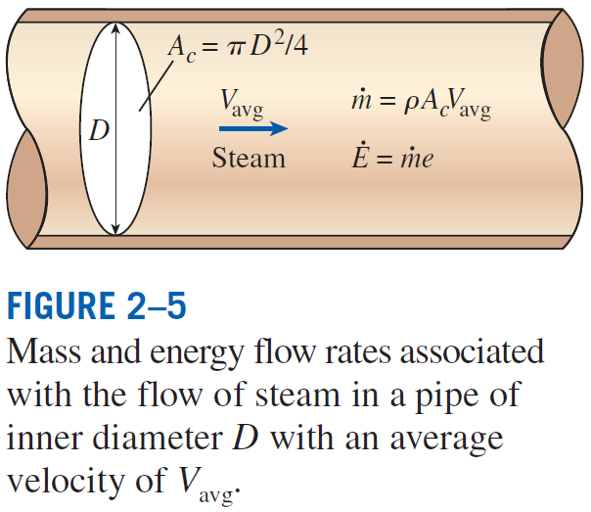

Slide 10
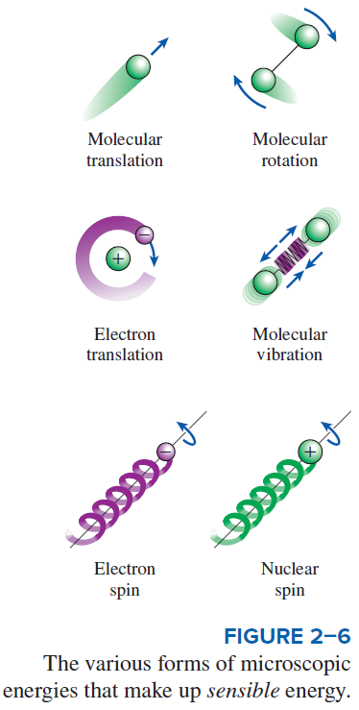
Some Physical Insight to Internal Energy
Sensible energy: The portion of the internal energy of a system associated with the kinetic energies of the molecules.
Latent energy: The internal energy associated with the phase of a system.
Chemical energy: The internal energy associated with the atomic bonds in a molecule.
Nuclear energy: The tremendous amount of energy associated with the strong bonds within the nucleus of the atom itself.

Slide 11
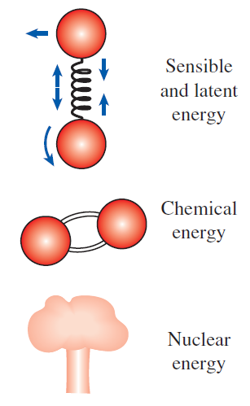
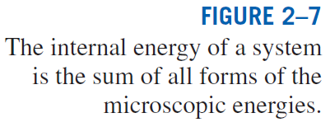
Thermal = Sensible + Latent
Internal = Sensible + Latent + Chemical + Nuclear

Slide 12
The total energy of a system, can be contained or stored in a system, and thus can be viewed as the static forms of energy.
The forms of energy not stored in a system can be viewed as the dynamic forms of energy or as energy interactions.
The dynamic forms of energy are recognized at the system boundary as they cross it, and they represent the energy gained or lost by a system during a process.
The only two forms of energy interactions associated with a closed system are
- heat transfer
- work
The difference between heat transfer and work: An energy interaction is heat transfer if its driving force is a temperature difference. Otherwise it is work.

Slide 13
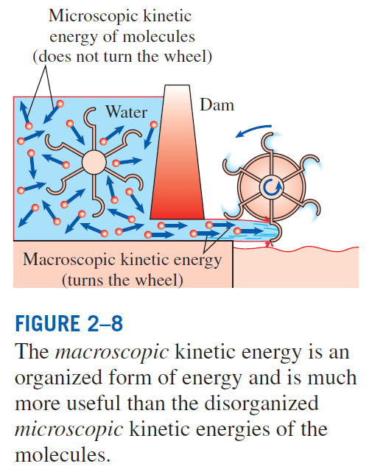

Slide 14
More on Nuclear Energy
The best known fission reaction involves the split of the uranium atom (the U-235 isotope) into other elements and is commonly used to generate electricity in nuclear power plants, to power nuclear submarines and aircraft carriers, and even to power spacecraft as well as building nuclear bombs.
Nuclear energy by fusion is released when two small nuclei combine into a larger one.
The uncontrolled fusion reaction was achieved in the early 1950s, but all the efforts since then to achieve controlled fusion by massive lasers, powerful magnetic fields, and electric currents to generate power have failed.

Slide 15
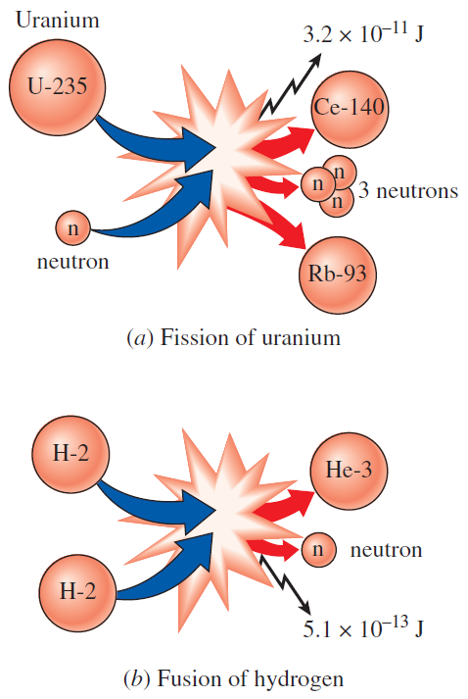
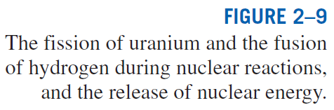

Slide 16
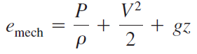
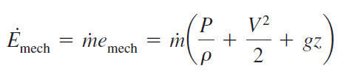
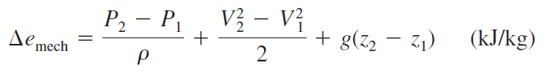
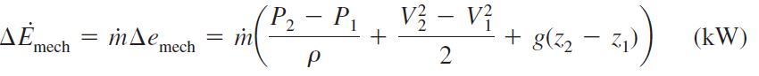
Mechanical Energy
Mechanical energy: The form of energy that can be converted to mechanical work completely and directly by an ideal mechanical device such as an ideal turbine.
Kinetic and potential energies: The familiar forms of mechanical energy.
Mechanical energy of a flowing fluid per unit mass
Rate of mechanical energy of a flowing fluid
Mechanical energy change of a fluid during incompressible flow per unit mass
Rate of mechanical energy change of a fluid during incompressible flow

Slide 17
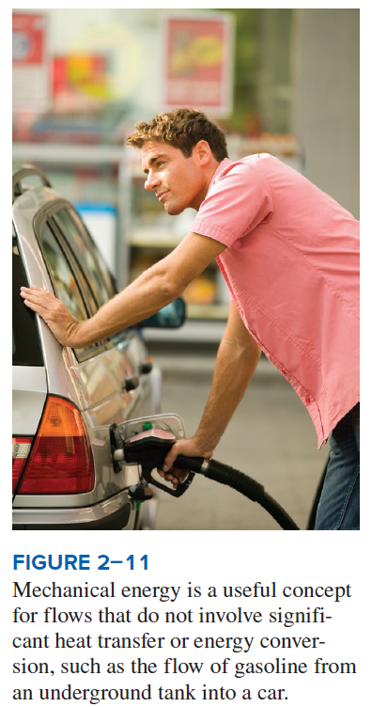

Slide 18
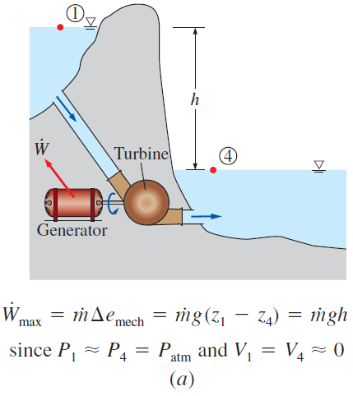
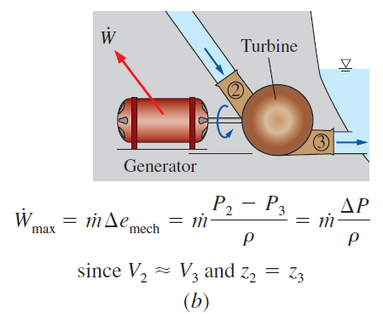
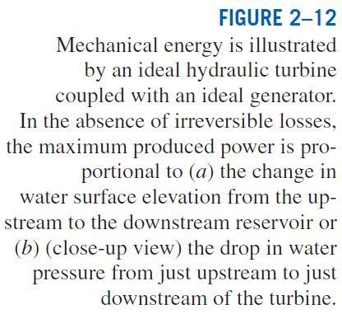

Slide 19
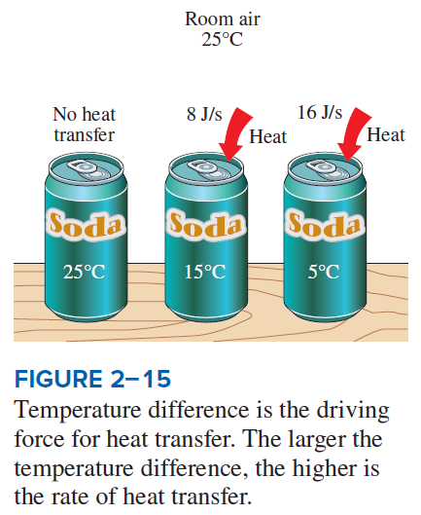
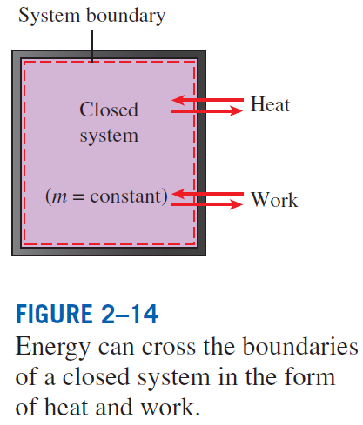
ENERGY TRANSFER BY HEAT
Heat: The form of energy that is transferred between two systems (or a system and its surroundings) by virtue of a temperature difference.

Slide 20
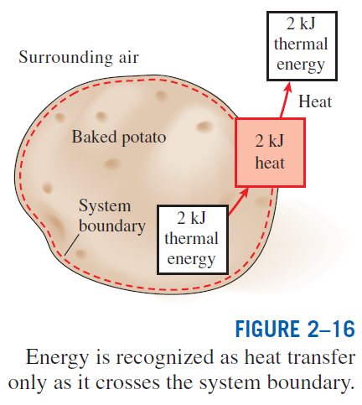
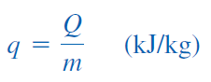
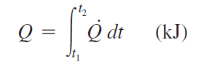
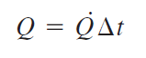
Heat transfer per unit mass
Amount of heat transfer when heat transfer rate is constant
Amount of heat transfer when heat transfer rate changes with time

Slide 21
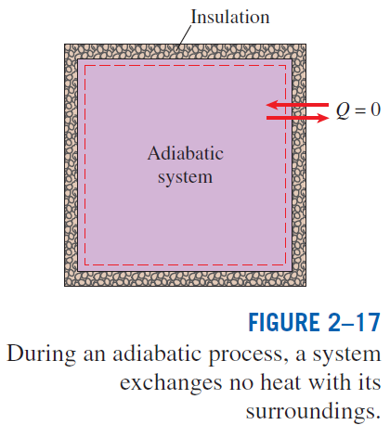
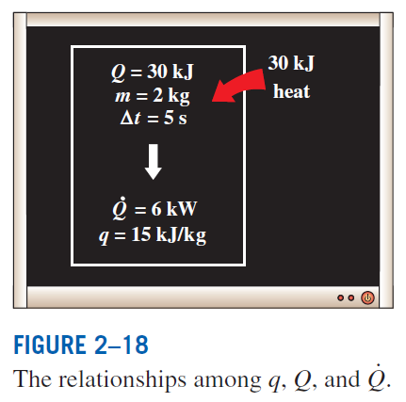

Slide 22
Heat transfer mechanisms
Conduction: The transfer of energy from the more energetic particles of a substance to the adjacent less energetic ones as a result of interaction between particles.
Convection: The transfer of energy between a solid surface and the adjacent fluid that is in motion, and it involves the combined effects of conduction and fluid motion.
Radiation: The transfer of energy due to the emission of electromagnetic waves (or photons).

Slide 23
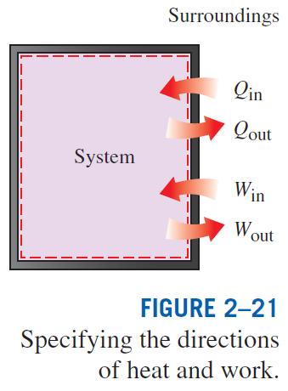
ENERGY TRANSFER BY WORK
Work: The energy transfer associated with a force acting through a distance.
A rising piston, a rotating shaft, and an electric wire crossing the system boundaries are all associated with work interactions
Formal sign convention: Heat transfer to a system and work done by a system are positive; heat transfer from a system and work done on a system are negative.
Alternative to sign convention is to use the subscripts in and out to indicate direction.
This is the primary approach in this text.

Slide 24
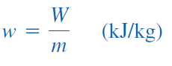
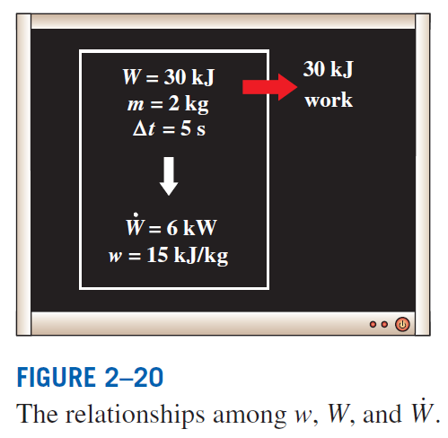
Work done per unit mass

Slide 25
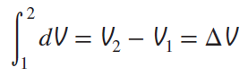
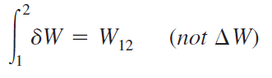
Heat vs. Work
Both are recognized at the boundaries of a system as they cross the boundaries. That is, both heat and work are boundary phenomena.
Systems possess energy, but not heat or work.
Both are associated with a process, not a state.
Unlike properties, heat or work has no meaning at a state.
Both are path functions (i.e., their magnitudes depend on the path followed during a process as well as the end states).
Properties are point functions have exact differentials (d).
Path functions have inexact differentials (δ )

Slide 26
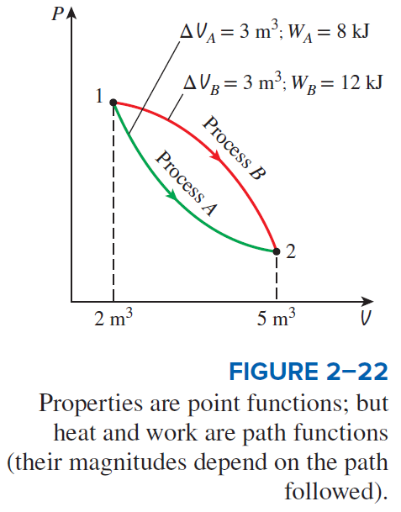

Slide 27
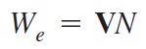
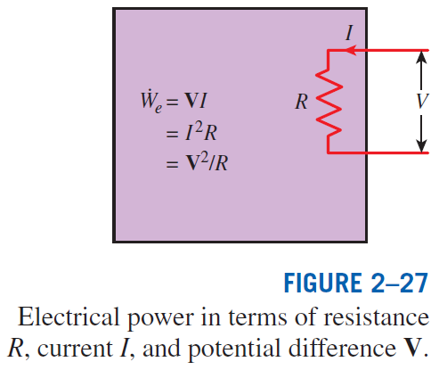
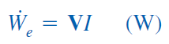
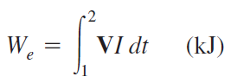

Electrical Work
Electrical work
Electrical power
When potential difference and current change with time
When potential difference and current remain constant

Slide 28
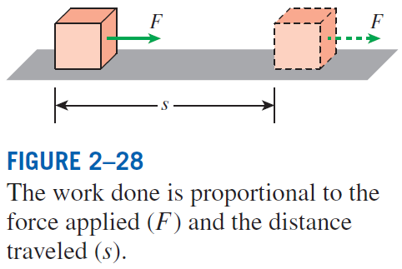
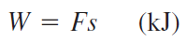
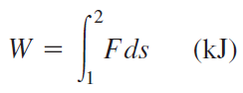
MECHANICAL FORMS OF WORK
There are two requirements for a work interaction between a system and its surroundings to exist:
- there must be a force acting on the boundary.
- the boundary must move.
Work = Force × Distance
When force is not constant

Slide 29
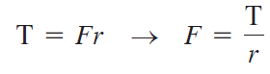
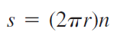



Shaft Work
A force F acting through a moment arm r generates a torque T
This force acts through a distance s
Shaft work
The power transmitted through the shaft is the shaft work done per unit time

Slide 30


Slide 31




Spring Work
When the length of the spring changes by a differential amount dx under the influence of a force F, the work done is
For linear elastic springs, the displacement x is proportional to the force applied
k: spring constant (kN/m)
Spring work
x₁ and x₂: the initial and the final displacements

Slide 32


Slide 33


Work Done on Elastic Solid Bars

Slide 34

Work Done to Raise or to Accelerate a Body
The work transfer needed to raise a body is equal to the change in the potential energy of the body.
The work transfer needed to accelerate a body is equal to the change in the kinetic energy of the body.

Slide 35
Nonmechanical Forms of Work
Electrical work: The generalized force is the voltage (the electrical potential) and the generalized displacement is the electrical charge.
Magnetic work: The generalized force is the magnetic field strength and the generalized displacement is the total magnetic dipole moment.
Electrical polarization work: The generalized force is the electric field strength and the generalized displacement is the polarization of the medium.

Slide 36

THE FIRST LAW OF THERMODYNAMICS
The first law of thermodynamics (the conservation of energy principle) provides a sound basis for studying the relationships among the various forms of energy and energy interactions.
The first law states that energy can be neither created nor destroyed during a process; it can only change forms.
First Law: For all adiabatic processes between two specified states of a closed system, the net work done is the same regardless of the nature of the closed system and the details of the process.

Slide 37


Slide 38



Slide 39



Slide 40



Energy Balance
The net change (increase or decrease) in the total energy of the system during a process is equal to the difference between the total energy entering and the total energy leaving the system during that process.

Slide 41




Energy Change of a System, ΔE_{system}
Internal, kinetic, and potential energy changes

Slide 42

Mechanisms of Energy Transfer, E_{in} and E_{out}

Slide 43


Mechanisms of energy transfer:
Heat transfer
Work transfer
Mass flow
A closed mass involves only heat transfer and work.

Slide 44



ENERGY CONVERSION EFFICIENCIES
Efficiency is one of the most frequently used terms in thermodynamics, and it indicates how well an energy conversion or transfer process is accomplished.
Efficiency of a water heater: The ratio of the energy delivered to the house by hot water to the energy supplied to the water heater.

Slide 45
Heating value of the fuel: The amount of heat released when a unit amount of fuel at room temperature is completely burned and the combustion products are cooled to the room temperature.
Lower heating value (LHV): When the water in the combustion gases is a vapor.
Higher heating value (HHV): When the water in the combustion gases is completely condensed and thus the heat of vaporization is also recovered.
Combustion equipment efficiency

Slide 46


Slide 47
The efficiency of space heating systems of residential and commercial buildings is usually expressed in terms of the annual fuel utilization efficiency (AFUE), which accounts for the combustion equipment efficiency as well as other losses such as heat losses to unheated areas and start-up and cooldown losses.
The AFUE of most new heating systems is about 85 percent, although the AFUE of some old heating systems is under 60 percent.
The AFUE of some new high-efficiency furnaces exceeds 96 percent, but the high cost of such furnaces cannot be justified for locations with mild to moderate winters.
Such high efficiencies are achieved by reclaiming most of the heat in the flue gases, condensing the water vapor, and discharging the flue gases at temperatures as low as 38°C (or 100°F) instead of about 200°C (or 400°F) for the conventional models.

Slide 48

Overall efficiency of a power plant
Generator: A device that converts mechanical energy to electrical energy.
Generator efficiency: The ratio of the electrical power output to the mechanical power input.
Thermal efficiency of a power plant: The ratio of the net shaft work output of the turbine to the heat input to the working fluid.
The overall efficiencies are about 25–30 percent for gasoline automotive engines, 35–40 percent for diesel engines, and up to 60 percent for large power plants.

Slide 49


Lighting efficacy: The amount of light output in lumens per W of electricity consumed.

Slide 50


Slide 51

Using energy-efficient appliances conserve energy.
It helps the environment by reducing the amount of pollutants emitted to the atmosphere during the combustion of fuel.
The combustion of fuel produces
carbon dioxide, causes global warming
nitrogen oxides and hydrocarbons, cause smog
carbon monoxide, toxic
sulfur dioxide, causes acid rain.

Slide 52


Slide 53



Efficiencies of Mechanical and Electrical Devices
Mechanical efficiency
The effectiveness of the conversion process between the mechanical work supplied or extracted and the mechanical energy of the fluid is expressed by the pump efficiency and turbine efficiency,

Slide 54



Slide 55




Pump-Motor overall efficiency
Turbine-Generator overall efficiency

Slide 56



Slide 57
ENERGY AND ENVIRONMENT
The conversion of energy from one form to another often affects the environment and the air we breathe in many ways, and thus the study of energy is not complete without considering its impact on the environment.
Pollutants emitted during the combustion of fossil fuels are responsible for smog, acid rain, and global warming.
The environmental pollution has reached such high levels that it became a serious threat to vegetation, wild life, and human health.

Slide 58



Slide 59
Ozone and Smog
Smog: Made up mostly of ground-level ozone (O₃), but it also contains numerous other chemicals, including carbon monoxide (CO), particulate matter such as soot and dust, volatile organic compounds (VOCs) such as benzene, butane, and other hydrocarbons.
Hydrocarbons and nitrogen oxides react in the presence of sunlight on hot calm days to form ground-level ozone.
Ozone irritates eyes and damages the air sacs in the lungs where oxygen and carbon dioxide are exchanged, causing eventual hardening of this soft and spongy tissue.
It also causes shortness of breath, wheezing, fatigue, headaches, and nausea, and aggravates respiratory problems such as asthma.
The other serious pollutant in smog is carbon monoxide, which is a colorless, odorless, poisonous gas. It is mostly emitted by motor vehicles.
It deprives the body’s organs from getting enough oxygen by binding with the red blood cells that would otherwise carry oxygen. It is fatal at high levels.
Suspended particulate matter such as dust and soot are emitted by vehicles and industrial facilities. Such particles irritate the eyes and the lungs.

Slide 60


Slide 61
Acid Rain
The sulfur in the fuel reacts with oxygen to form sulfur dioxide (SO₂), which is an air pollutant.
The main source of SO₂ is the electric power plants that burn high-sulfur coal.
Motor vehicles also contribute to SO₂ emissions since gasoline and diesel fuel also contain small amounts of sulfur.
The sulfur oxides and nitric oxides react with water vapor and other chemicals high in the atmosphere in the presence of sunlight to form sulfuric and nitric acids.
The acids formed usually dissolve in the suspended water droplets in clouds or fog.
These acid-laden droplets, which can be as acidic as lemon juice, are washed from the air on to the soil by rain or snow. This is known as acid rain.

Slide 62


Slide 63

The Greenhouse Effect: Global Warming and Climate Change
Greenhouse effect: Glass allows the solar radiation to enter freely but blocks the infrared radiation emitted by the interior surfaces. This causes a rise in the interior temperature as a result of the thermal energy buildup in a space (i.e., car).
The surface of the earth, which warms up during the day as a result of the absorption of solar energy, cools down at night by radiating part of its energy into deep space as infrared radiation.

Slide 64
Carbon dioxide (CO₂), water vapor, and trace amounts of some other gases such as methane and nitrogen oxides act like a blanket and keep the earth warm at night by blocking the heat radiated from the earth. The result is global warming.
These gases are called “greenhouse gases,” with CO₂ being the primary component.
CO₂ is produced by the burning of fossil fuels such as coal, oil, and natural gas.

Slide 65
A 1995 report: The earth has already warmed about 0.5°C during the last century, and they estimate that the earth’s temperature will rise another 2°C by the year 2100.
A rise of this magnitude can cause severe changes in weather patterns with storms and heavy rains and flooding at some parts and drought in others, major floods due to the melting of ice at the poles, loss of wetlands and coastal areas due to rising sea levels, and other negative results.
How to minimize global warming?
Improved energy efficiency
energy conservation
using renewable energy sources

Slide 66


The average car produces several times its weight in CO₂ every year (it is driven 20,000 km a year, consumes 2300 liters of gasoline, and produces 2.5 kg of CO₂ per liter).

Slide 67
Summary
Forms of energy
Energy transfer by heat
Energy transfer by work
Mechanical forms of work
The first law of thermodynamics
Energy conversion efficiencies
Energy and environment

